Slide 1
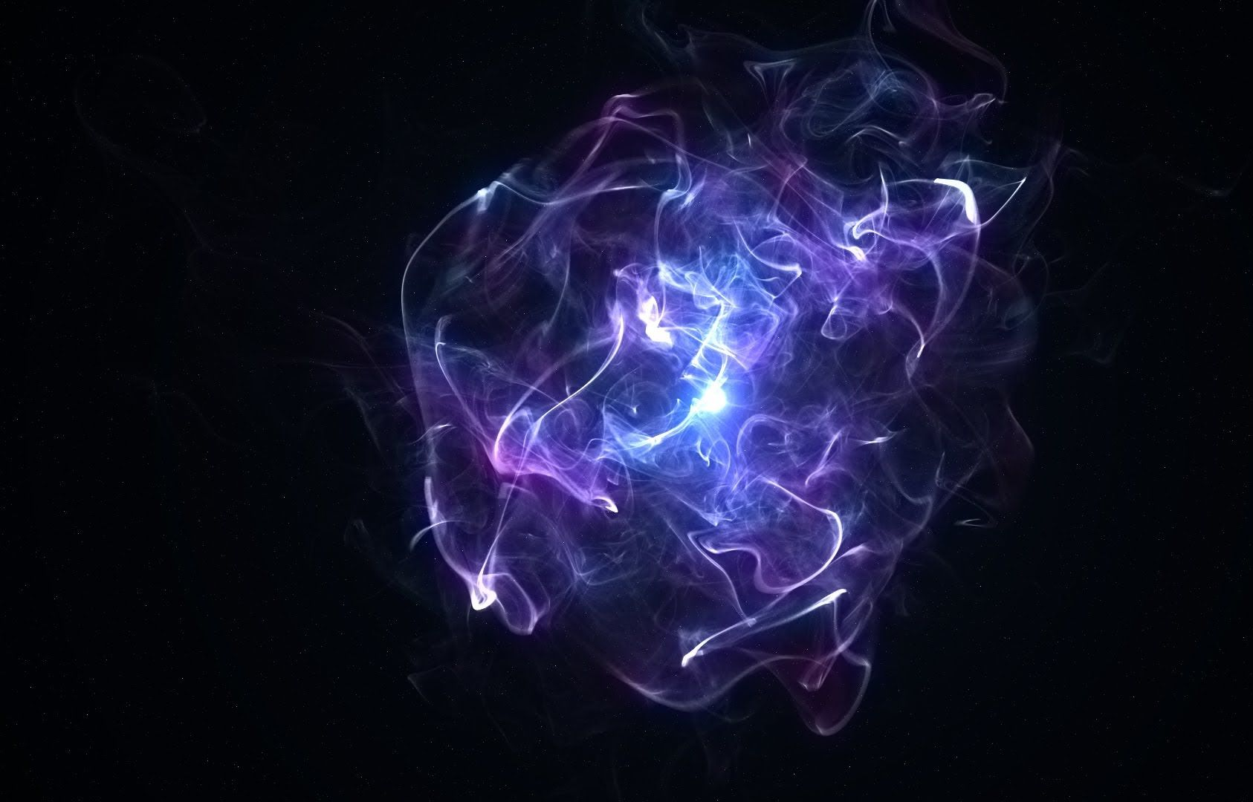
Unity Visual Effect Graph
Pham Thi Hong Sam
Vu Phuong Hoang

Slide 2
^{What is Visual Effect ?}

Slide 3
VFX
Game
VFX
Particle
VFX
Notes:
VFX: Motion Blur, Groot, Dr Strange's ring ...
Game VFX: REAL TIME

Slide 4
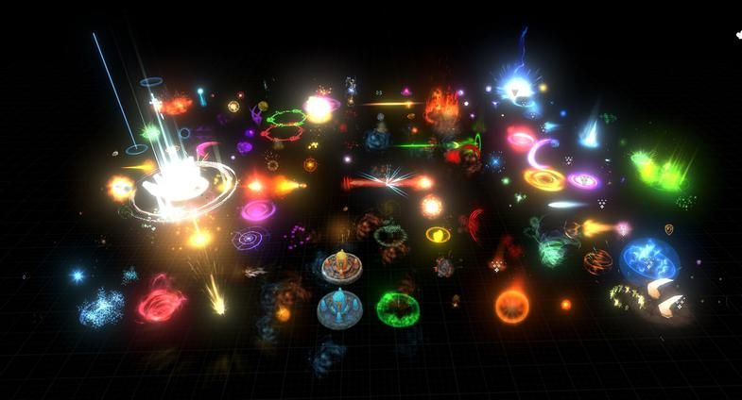
Particle Effects
Effects made by many particles:
Fire
Smoke
Dust
Magic spells
Projectiles
Debris
…

Slide 5
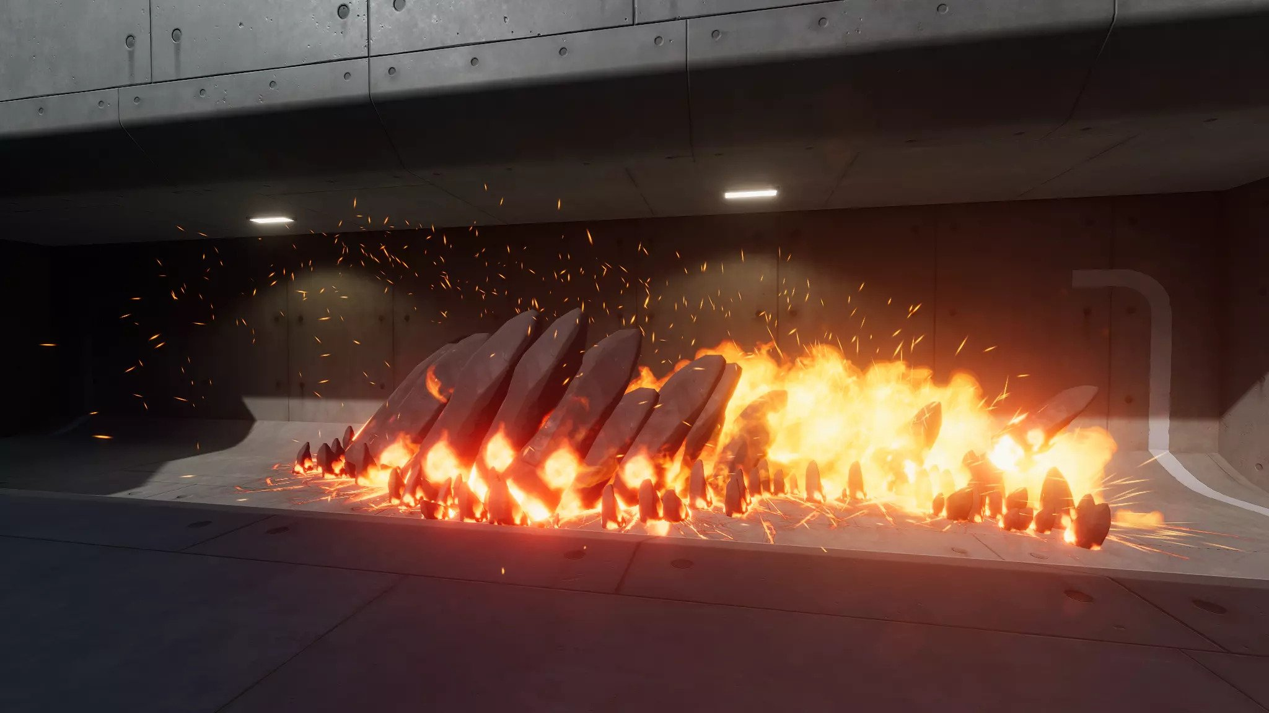
How we MADE them ?
Particle Systems:
Unity’s Shuriken
Unreal’s Cascade
Houdini
Adobe After Effect
Sprite Sheet

Slide 6
How SHALL we make them ?

Slide 7
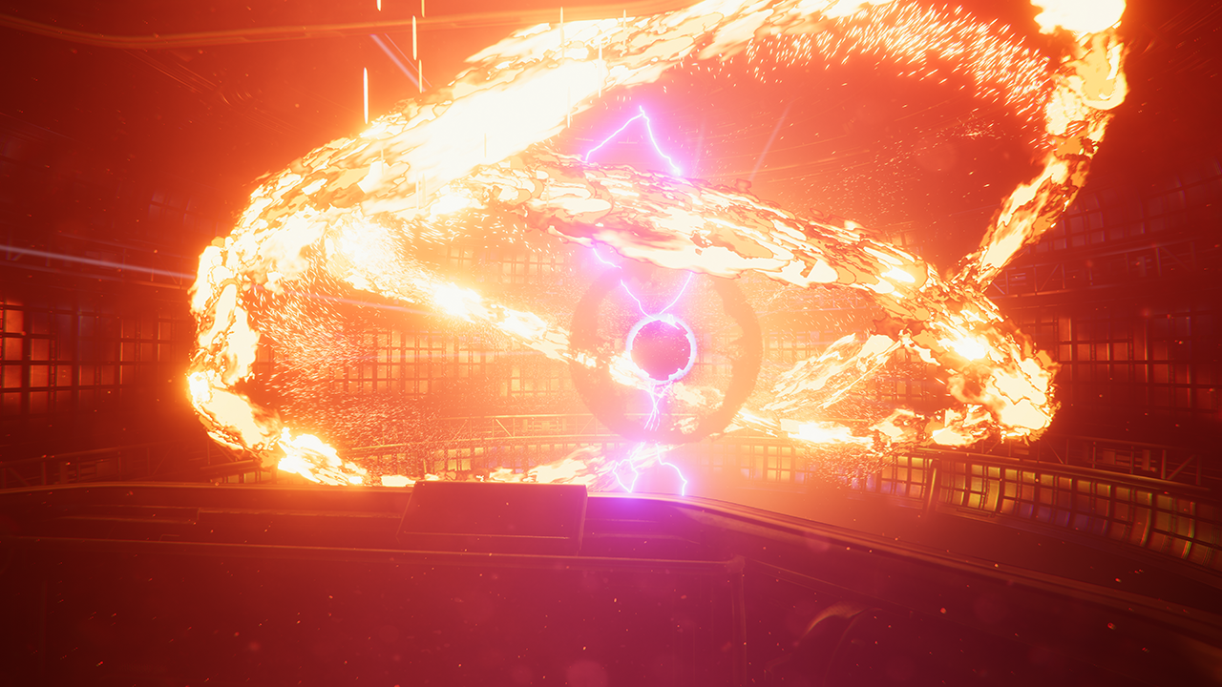

Unity Visual Effect Graph
Notes:
https://www.youtube.com/watch?v=rqMcPZoEc3U

Slide 8
When
How
Where
VFX
Graph
Why
What

Slide 9
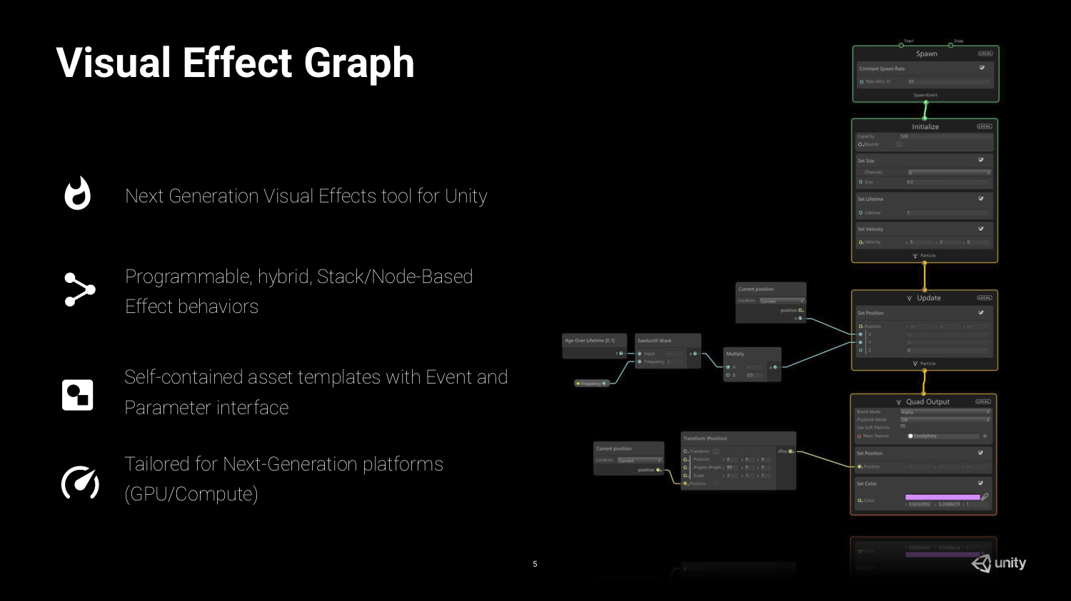

Slide 10
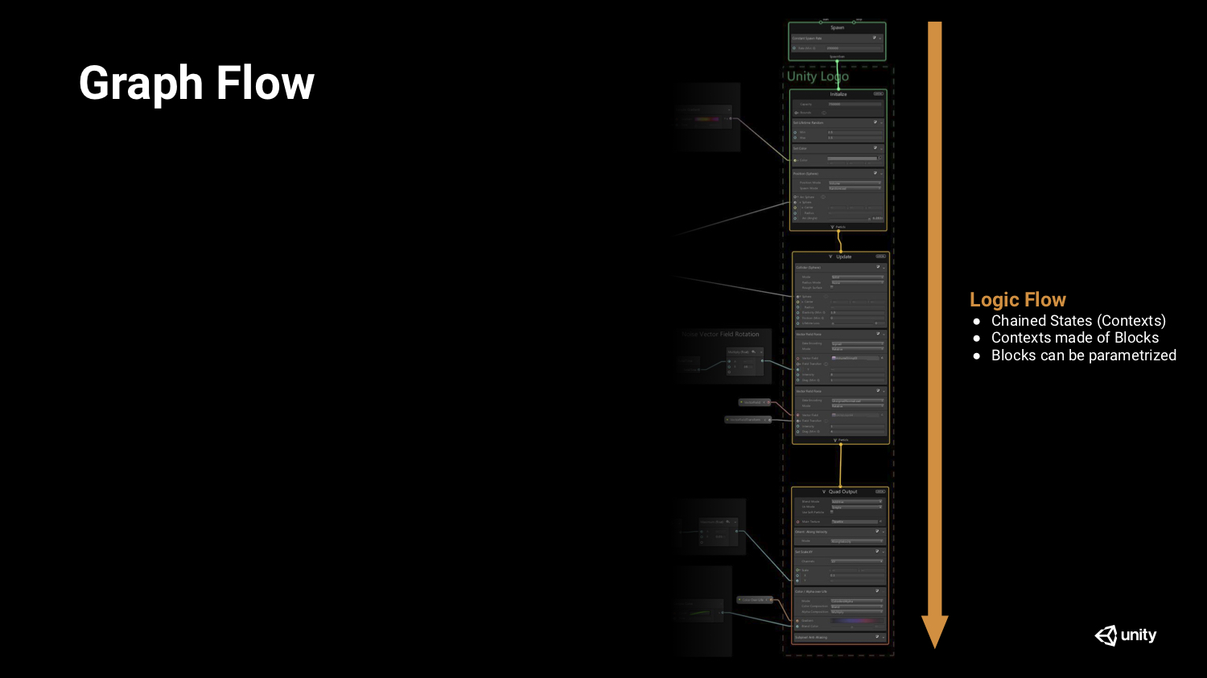

Slide 11
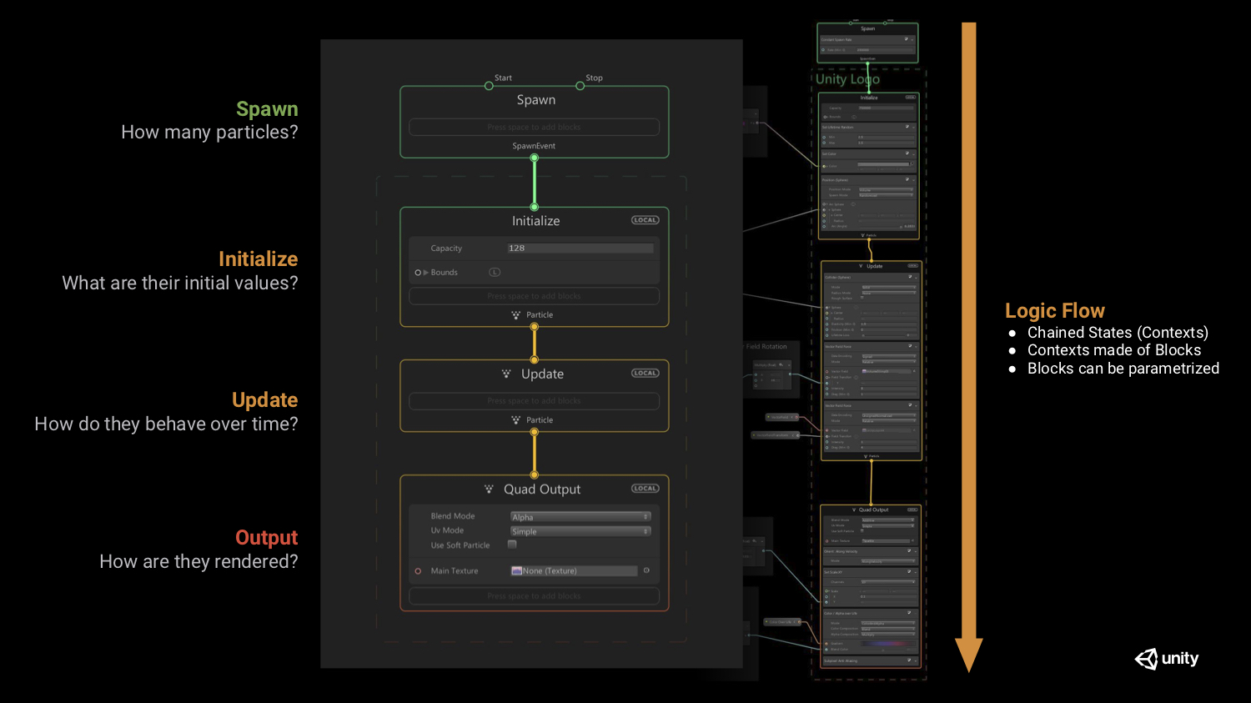
Notes:
Context: Make up a chain [ Spawn -> Initialize -> Update -> (Quad) Output ]
Spawn:
- When to start this chain ?
- How many particles will be emitted ?
- When each particle will be emitted ?
Initialize:
- Max particles (Capacity) ?
- Initial position, rotation, scale, velocity, ...
- Lifetime
Update: How will particles be updated over time ?
(Quad) Output:
- How to render each particles ? (mesh, material, shader, texture, color ... )
- Facing behavior (Billboard ...)

Slide 12
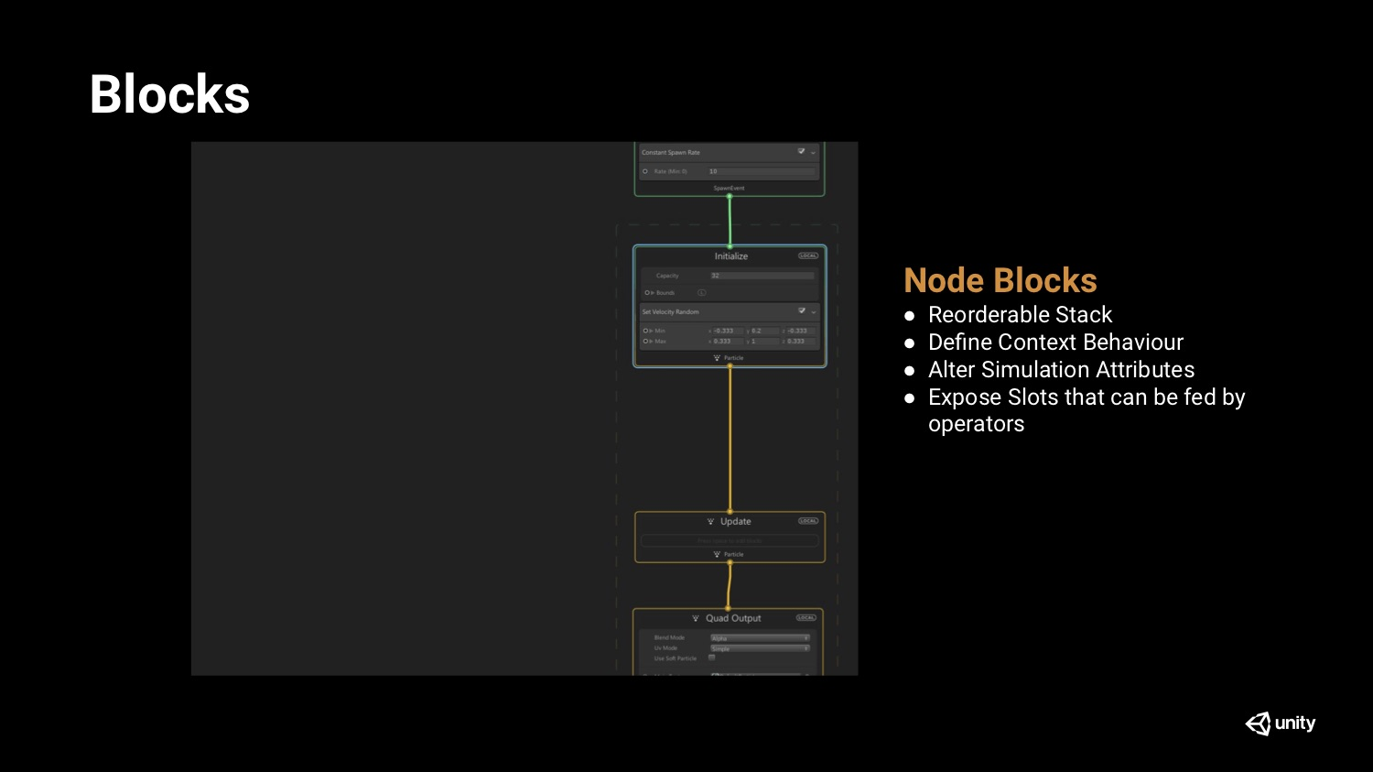

Slide 13
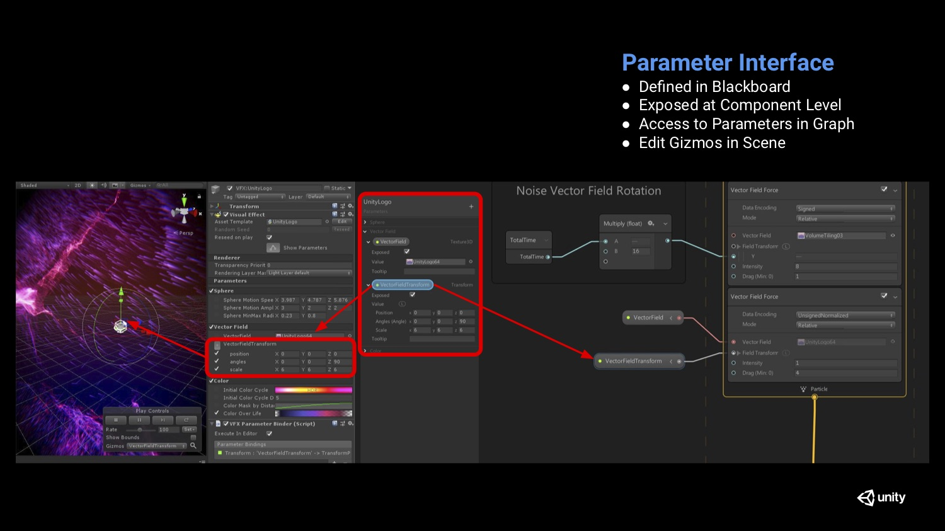

Slide 14
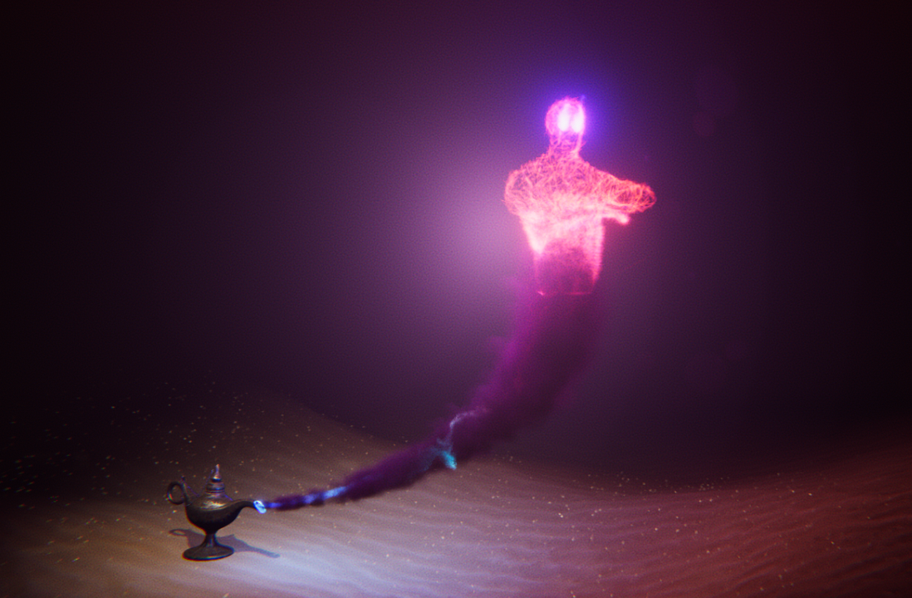
Let’s make one !

Slide 15
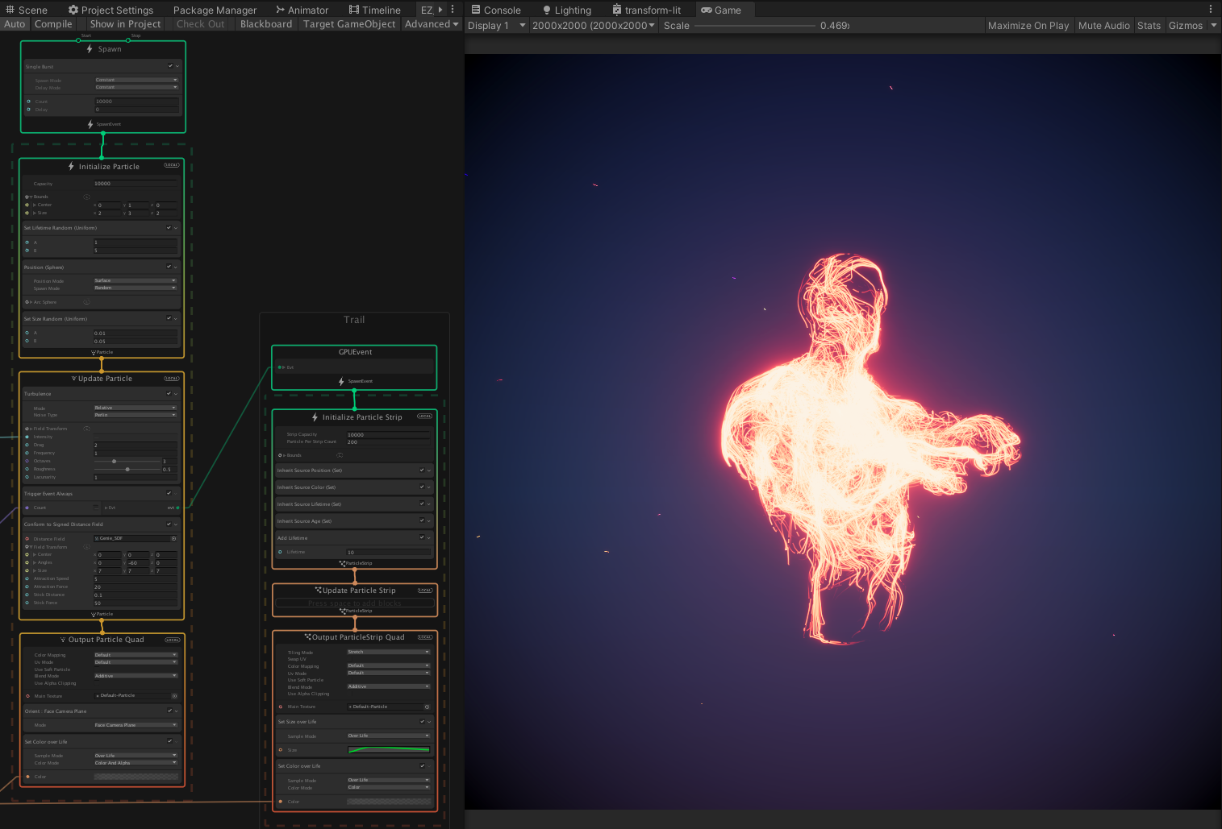
_{Burst}
_{On sphere}
_{Spawn trail for}
_{each particle}
_{Turbulence}
_{with delay}
_{Same position}
_{Conform to}
_{mesh surface (SDF)}
_{Age}
_{Change size & color over time}
_{Change color}
_{over time}

Slide 16

Let’s break one !

Slide 17
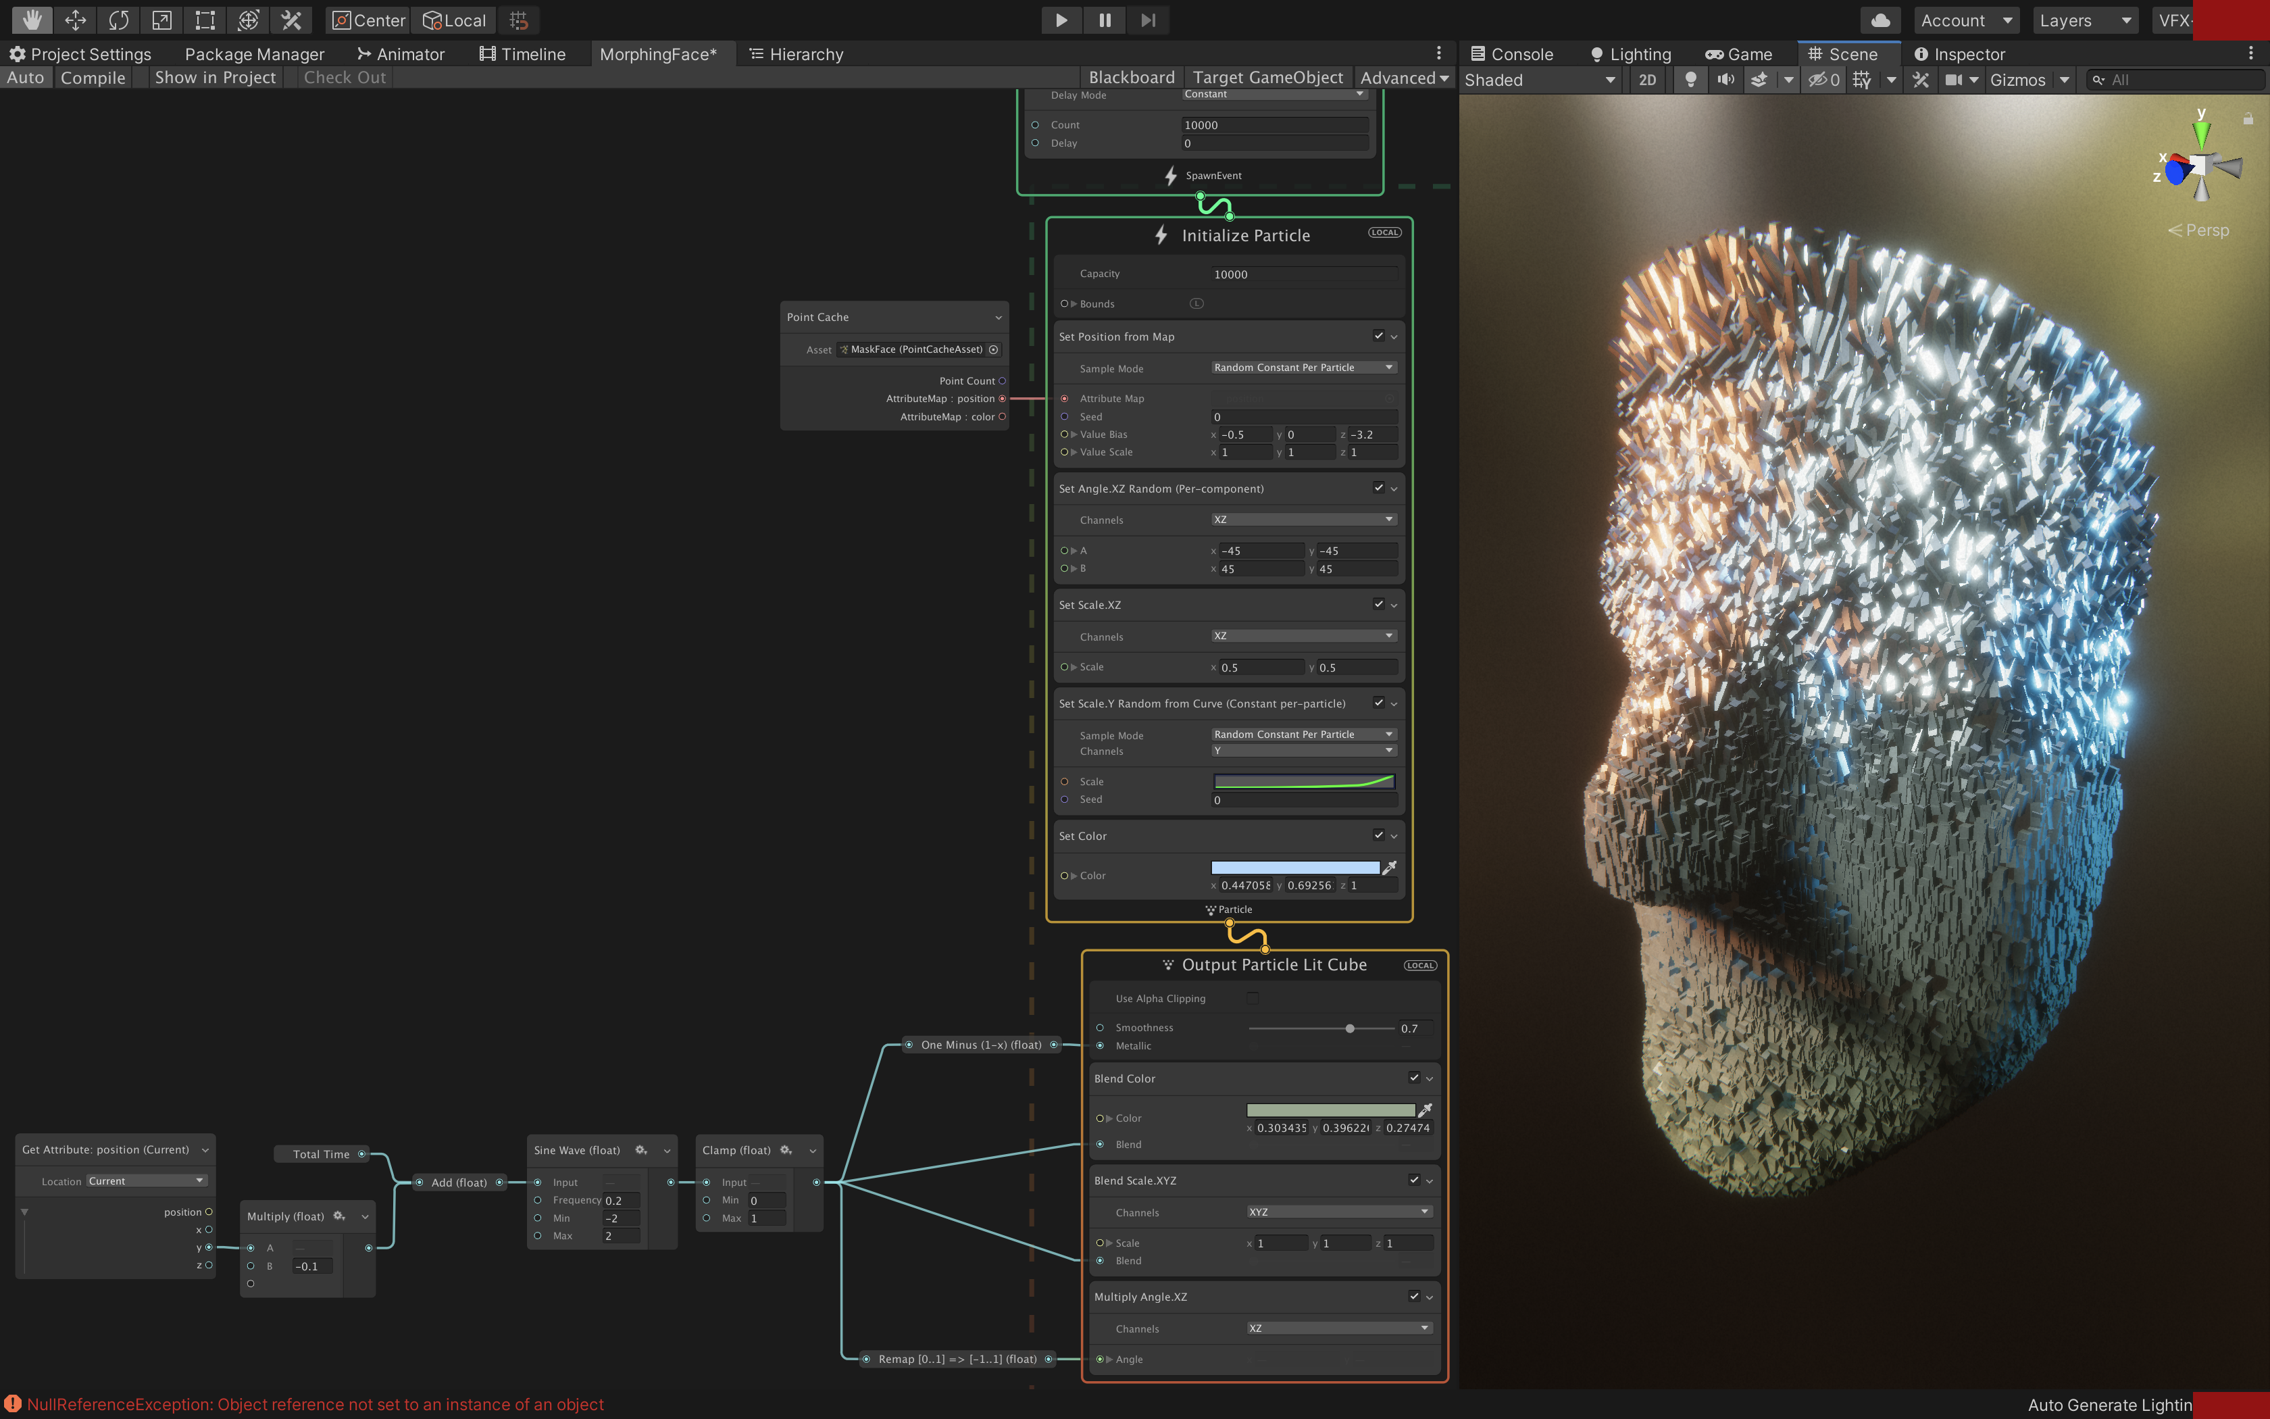
_{Burst 10K cubes}
_{On mesh surface}
_{Random rotation} _{& scale}
_{Ageless}
_{Loop by sine wave}
_{Let Y contribute}
_{Blend 2 values}
_{Convert ranges}

Slide 18
Shuriken
VFX Graph
Work on CPU
10K particles
Average performance
Work on GPU
10M particles
Great performance

Slide 19
Shuriken
VFX Graph
Work on CPU
10K particles
Average performance
All options are visible
Work on GPU
10M particles
Great performance
Steep learning curve

Slide 20
Shuriken
VFX Graph
Work on CPU
10K particles
Average performance
All options are visible
For all Unity versions, all platforms
Work on GPU
10M particles
Great performance
Steep learning curve
Only for new Unity versions / platforms

Slide 21
Shuriken
VFX Graph
Work on CPU
10K particles
Average performance
All options are visible
For all Unity versions, all platforms
Limited options
Limited tools
Fixed
Need engineer for dynamic ones
Bad for collaborations
Work on GPU
10M particles
Great performance
Steep learning curve
Only for new Unity versions / platforms
More freedom
More tools (Point-Cache, Vector Field …)
Variants by exposed properties
Dynamic via binders
Pack-able support from engineer (SubGraph)

Slide 22

Why should I learn it ?
Alternative for complex effects
Production-ready after 2 years in Preview

Slide 23
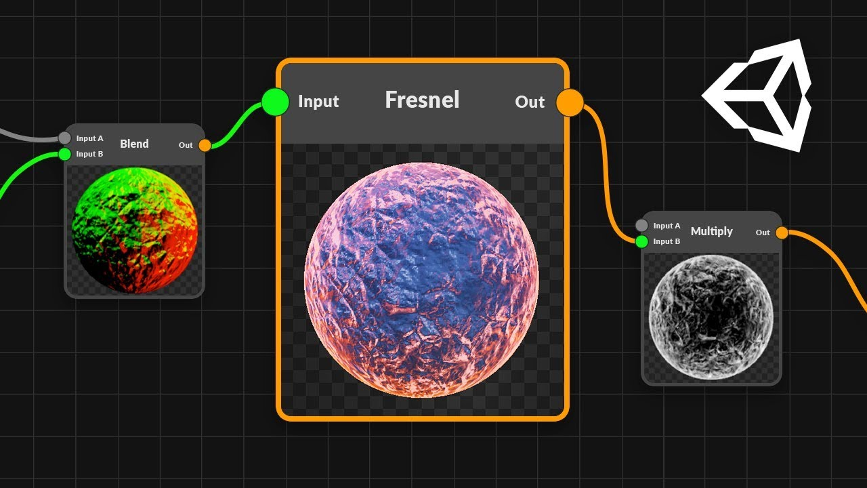
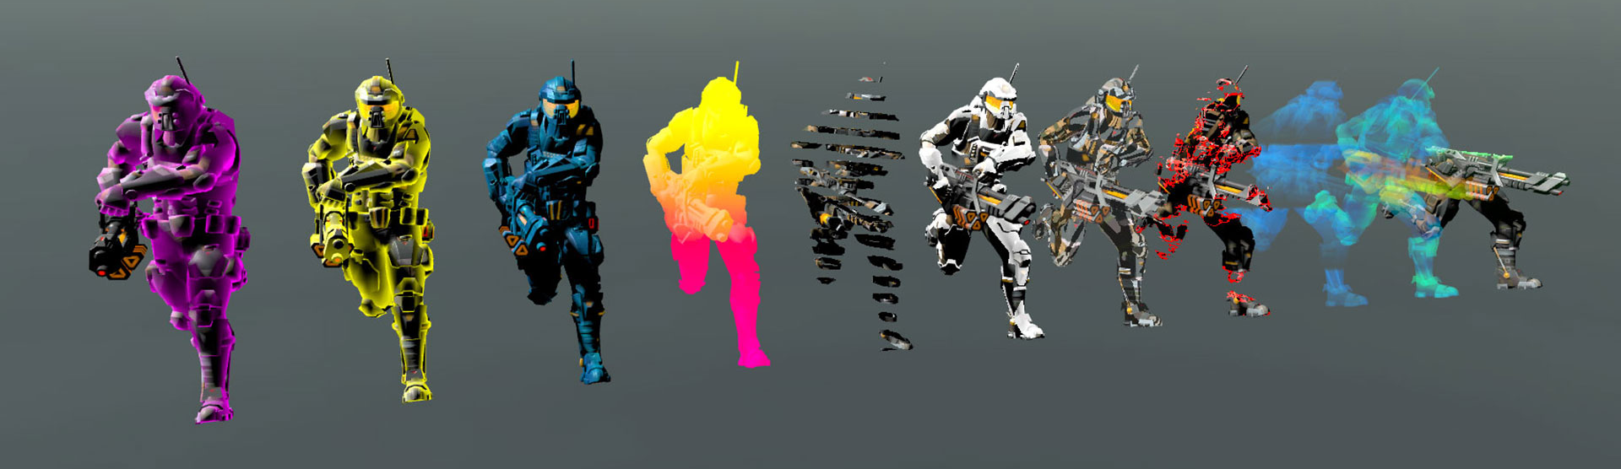
Why should I learn it ?
Alternative for complex effects
Production-ready after 2 years in Preview
Node-based editors are the future
Unreal’s Blueprint, Material Editor
Unity’s Shader Graph, Bolt
Substance Material Editor …

Slide 24

References
Official homepage
Latest documentation (incompleted)
Block list (out-dated)
VFX Graph Samples
Spaceship demo

Slide 25
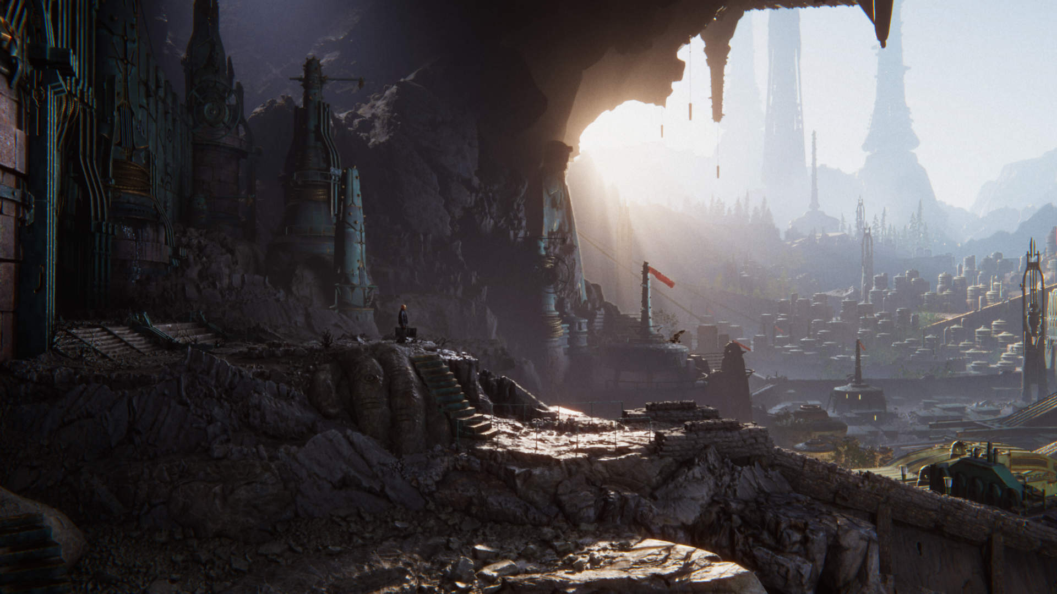
More topics about Unity Graphics
Shader Graph
Post Processing
Global illumination
Notes:
https://youtu.be/uUHRJ26gMGI?t=23

Slide 26
Q & A

